Slide 1
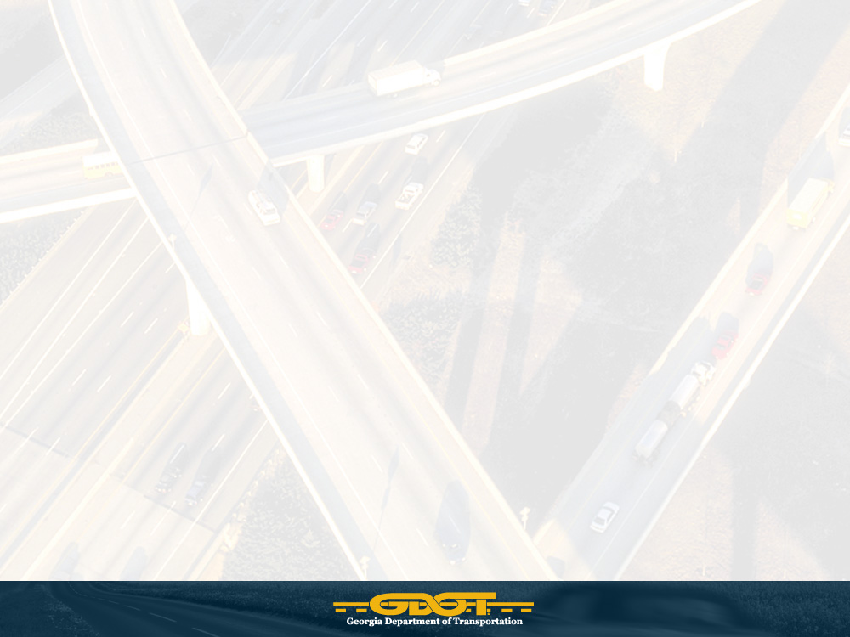
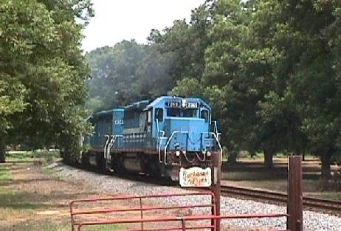
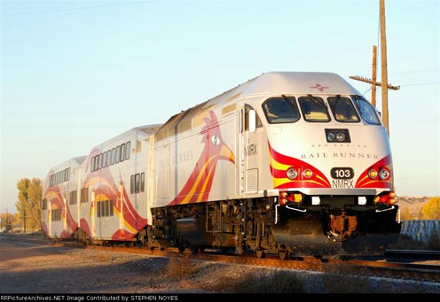
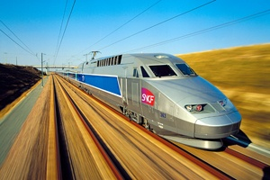
The State of Rail in Georgia
Georgia Railroad Association
Erik Steavens
Intermodal Director
November 17, 2009

Slide 2
2009 Georgia State Rail Plan
  Document to satisfy FRA’s requirements
  Plan allows GDOT to apply for stimulus funding
  Plan to comply with all federal planning guidelines
    Passenger Rail Investment & Improvement Act
    (PRIIA) of 2008 sections 303, 307, & 501
    Title 49 Part 266 CFR – Description &
    Assessment of the state’s rail system

Slide 3
Need For General Rail Investment
Growth in the last two decades at an unparallel rate
Focus on mobility of people and goods
Growing port activities
Burgeoning freight rail activity
Investments in airports and highway system unable to
relieve congestion
Untapped capacity in existing railroads

Slide 4
Freight Rail
CSX / NS Mileage:
CSX: 1,626
NS: 1,930
Other Mileage (23): 1,483
Total: 5,039
GDOT Mileage: 540
GEORGIA RAILROAD SYSTEM
Athen's Branch Railroad ABR 19
Chattahoochee & Gulf CGR 2
Chattahoochee Industrial CIRR 15
Chattooga & Chickamauga CCKY 68
Georgia Central GCR 152
Georgia & Florida Railnet GFRR 232

Slide 5
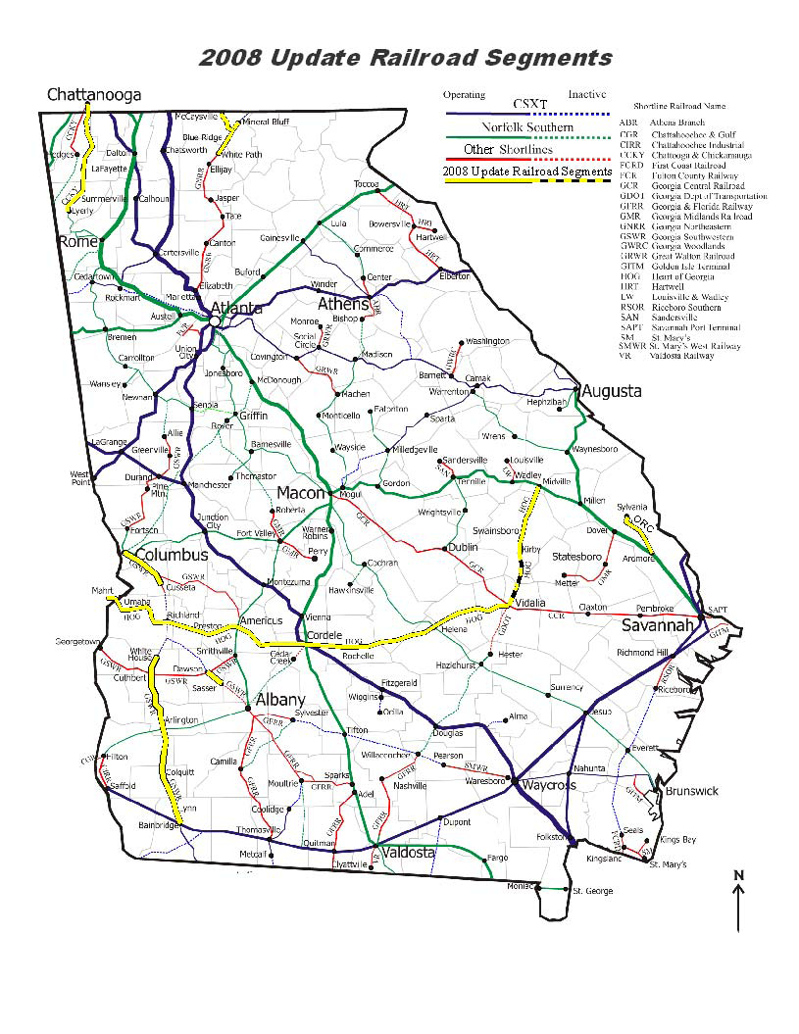

Slide 6
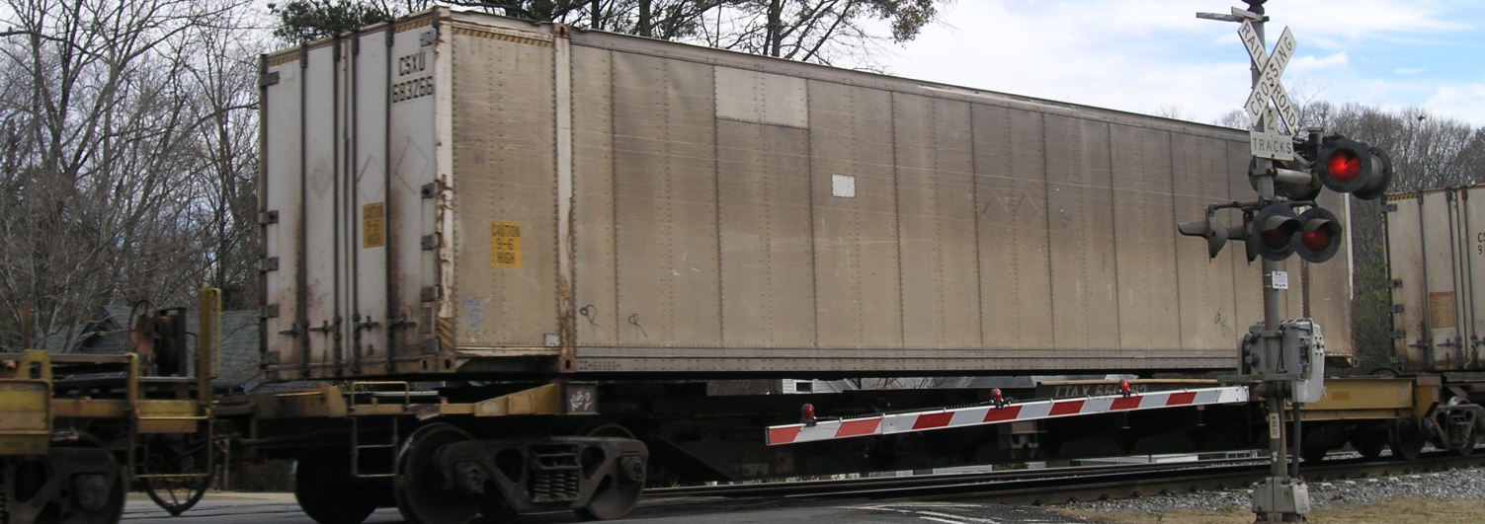
Rail Tonnage
2005 2030 % Change
Local 64,409 190,294 195%
Outbound 2,961,223 7,261,757 145%
Inbound 31,498,838 50,759,616 61%
Through Rail 75,271,239 92,502,628 23%
TOTAL 109,795,708 150,714,295 37%

Slide 7
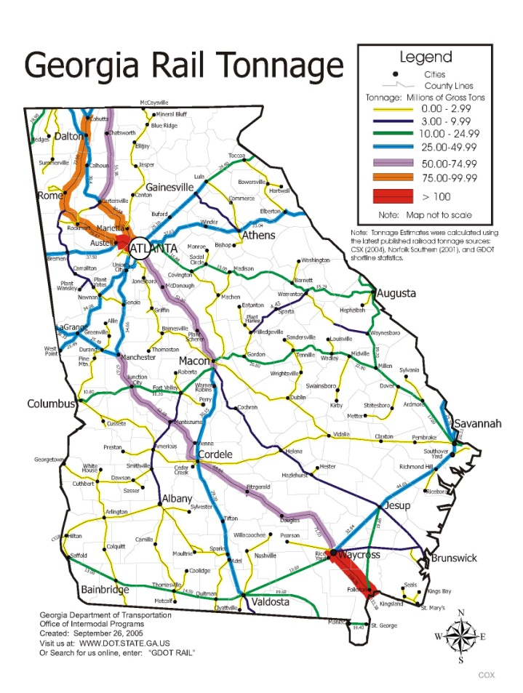
Freight tonnage moves through Georgia from many locations
Mobile, Alabama
New Orleans, Louisiana
Tampa, Florida
Jacksonville, Florida
Savannah, Georgia
Brunswick, Georgia

Slide 8
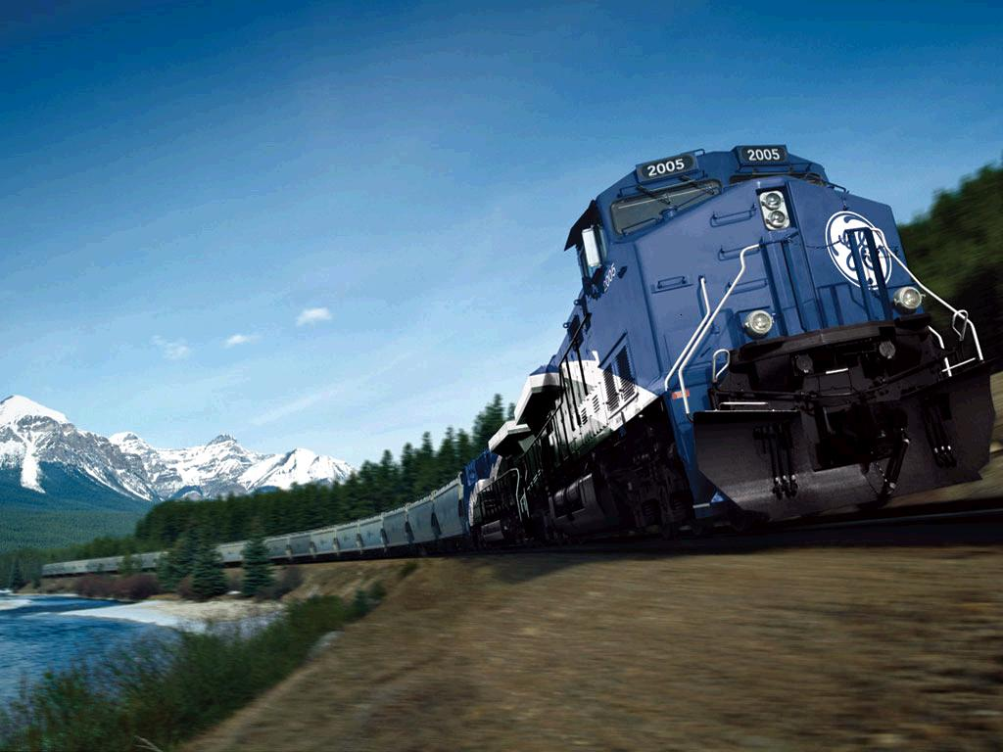
Investment In State Owned Rail
2004 - 2009
Cordele/Cedar Creek Ind. Park $344,950.00 2004
Midville /Kirby Georgia $500,000.00 2004
Fort Benning Bridge Repairs $145,000.00 2004
Rail Replacement, White Path/McCaysville $ 20, 457.00 2004
Valdosta – Willacoochee $2,318,000.00 2005
NS/CSX connection to Brunswick $1,000,000.00 2005
Hedges /Chattanooga Bridge work $186,525.50 2006
Atlantic Wood/ City of Vidalia $1,500,000.00 2007
Rochelle/Preston Bridge Repair $ 24,700.00 2007
Vidalia/ Rochelle Bridge Repair $ 89,831.00 2007
Midville/Vidalia Bridge Repair $ 20,713.00 2007
Jesup/Odum Siding NS $1,050,000.00 2009
Total $7,200,176.50

Slide 9
Neighboring State Investment
North Carolina Department of Transportation.
Program Fiscal Year 2007 - 2008
State Resources
Administration $679,535
Operations and Facilities $7,445,000
Rail Industrial Access $1,750,000
Engineering and Safety $1,750,000
Environmental and Planning $750,000
Travel Time Improvements $1,200,000
Maintenance of Rail Infrastructure $2,100,000
Rail Capacity and Safety $2,856,153
Grants to Shortlines (non-recurring) $1,000,000
Streamline Freight Operations (non-recurring) $3,850,000
Highway Trust Fund – Economic Alternative for
Highway Construction $5,000,000
Total State Budget for Rail Transportation $28,390,688
Tennessee Department of Transportations
Summary of Strategic Investments
10 yr plan 2006-2016
Investment millions Bike/Pedestrian Safety $ 5
Programs New Bike/Pedestrian Facilities $ 10
Rural Transit Expansion $100
Urban Transit Expansion $300
Transit New Starts $400
Demand Management (TDM) $ 30
Intelligent Transportation $ 50
Systems (ITS) Urban Highways $200
Highway Safety and Geometric $300
Waterway System Modernization and Facilities $ 15
Improvements Rail Freight Safety and $ 25
Modernization Rural Freight Capacity $ 40
County Seat Connectors $100
Short Line Railroads $125
Rural Highways $300
Total 10 year rail investment $150,000,000

Slide 10
CSX Transportation Identified Bottlenecks
Abbeville Sub (Atlanta to Charlotte) – capacity improvements
SW Atlanta Connectivity – train velocity, capacity, and routing options/flexibility
Bowline (Montgomery to Bainbridge to Waycross) – connectivity/capacity/clearances
Fitzgerald Sub (Atlanta to Waycross) – capacity and traffic fluidity
Yard Improvements (throughout state) – capacity and efficiency/thru put
Manchester Sub (Atlanta routings) – capacity and fluidity
Etowah Sub (Atlanta to Etowah, TN) – siding capacity
Nahunta Sum (Waycross to Jacksonville) – capacity and velocity
A-Line Improvements (Savannah to Florida) – capacity and velocity
Norfolk Southern Railway Identified Bottlenecks
Atlanta – Birmingham: Capacity and Velocity
Macon – Savannah: Capacity and Velocity
Macon Terminal: Capacity/ thru put

Slide 11
Yearly Maintenance Investment Requirements
2010-2012 Fiscal Year Near Term Capital Investment Requirements to maintain current service level and weight restrictions
461 Miles Total $37,035,000 $26,779 Avg. Per Route Mile
2013-2019 Fiscal Year Medium Term Capital Investment Requirements to maintain current service level and weight restrictions
Total $32,420,000 $9,250 Avg. Per Route Mile
Post 2019 Yearly Maintenance Investment Requirements maintain to current service level and weight restrictions (in 2009 dollars)
461 miles Total $4,234,000.00 $9,619 Avg. Per Route Mile
Rail Improvement (upgrade of current rail to 100# rail units)
158.1 miles Total $81,470,000 $515,307 Avg. Per Mile
100# rail upgrade will allow for 286,000 carloads over current 263,00 lb carloads and will accept future 315,000 LB carloads (2015)

Slide 12
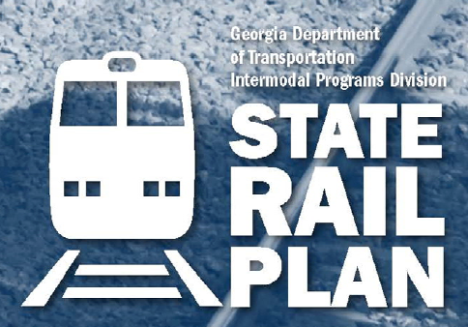
Get your copy of the State Rail Plan
Got to GDOT Website or this link
http://www.dot.state.ga.us/travelingingeorgia/staterail/Pages/default.aspx

Slide 13
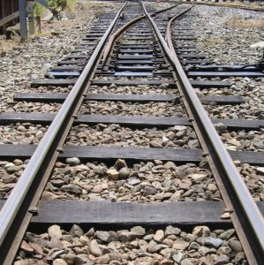
Questions

