Slide 1
Railroad Bridges
The proposed FRA rules and
The Philosophy and Procedures of Bridge Inspections
Presented By: Stanley Beaver & Doug Cochran

Slide 2
Bridges: An Overview and History of the Proposed FRA Bridge Rules
By Stanley Beaver
Director of Safety and Environmental Services

Slide 3
Railroad Bridge Working Group Report
The Railroad Safety Advisory Committee (RSAC) of the Federal Railroad Administration (FRA) constituted the Railroad Bridge Working Group (RBWG) on February 20, 2008 with the following assignment: “Report to the Federal Railroad Administrator on the current state of railroad bridge safety management, updating the findings and conclusions of the 1993 Summary Report of the FRA Railroad Bridge Safety Survey, including recommendations for further action.”

Slide 4
2008 Bridge Count for US Railroads
Railroad Classification | Number of Bridges | Miles of Bridges
 |  | Metal | Masonry | Timber | Total
Class 1 Freight | 60,688 | 792.26 | 368.92 | 278.02 | 1,439.20
Passenger | 2,129 | 36.16 | 17.74 | 0.24 | 54.14
Short Line & Regional | 14,033 | 106.64 | 20.24 | 140.01 | 266.88
GRAND TOTAL | 76,850 | 935.05 | 406.90 | 418.27 | 1,760.22
1993 Percent |  | 47% | 17% | 36%
2008 Percent |  | 53% | 23% | 24%

Slide 5
2008 Bridge Count for US Railroads continued
Railroad Classification | Track Miles | Route Miles | Bridges per Mile | Feet per Bridge | Bridge Feet per Mile
Class 1 Freight | 162,924 | 94,614 | 0.64 | 125.21 | 80.32
Passenger | 3,266 | 1,629 | 1.31 | 134.27 | 175.48
Short Line & Regional | 25,125 | 22,226 | 0.63 | 100.42 | 63.40
GRAND TOTAL | 191,315 | 118,469 | 0.65 | 120.94 | 78.45

Slide 6
Sec. 237.5 Application.
(a) Except as provided in paragraphs (b) or (c) of this section, this part applies to all owners of railroad track with a gage of two feet or more and which is supported by a bridge.

Slide 7
237.7 Responsibility for compliance.
(a) Except as provided in paragraph (b) of this section, an owner of track to which this part applies is responsible for compliance.
(b) If an owner of track to which this part applies assigns responsibility for the bridges which carry the track to another person (by lease or otherwise), written notification of the assignment shall be provided to the appropriate FRA Regional Office at least 30 days in advance of the assignment.

Slide 8
237.9 Definitions.
Bridge modification means a change to the configuration of a
railroad bridge that affects the load capacity of the bridge.
Bridge repair means remediation of damage or deterioration which has affected the structural integrity of a railroad bridge.
Railroad bridge means any structure with a deck, regardless of
length, which supports one or more railroad tracks, and any other
under grade structure with an individual span length of 10 feet or more located at such a depth that it is affected by live loads.
Track owner means a person responsible for compliance in accordance with §Sec. 237.7 of this part chapter.

Slide 9
Sec. 237.11 Penalties.
(a) Any person who violates any requirement of this part or causes the violation of any such requirement is subject to a civil penalty of at least $650 and not more than $25,000 per violation, except that:
Penalties may be assessed against individuals only for willful violations, and, where a grossly negligent violation or a pattern of repeated violations has created an imminent hazard of death or injury to persons, or has caused death or injury, a penalty not to exceed $100,000 per violation may be assessed

Slide 10
237.33 Adoption of bridge management programs.
(a) (Effective date of the final rule + 6 months): Class I carriers;
(b) (Effective date of the final rule + 6 months): Owners of track segments which are part of the general railroad system of
transportation and which carry more than ten scheduled passenger trains per week;
(c) (Effective date of the final rule + 12 months): Class II
carriers to which paragraph (b) of this section does not apply; and
(d) (Effective date of the final rule + 24 months): All other track
owners subject to this part and not described above.

Slide 11
237.35 Content of bridge management programs.
Each bridge management program adopted in compliance with this part shall include, as a minimum, the following provisions:
(a) An accurate inventory of railroad bridges, which shall include a unique identifier for each bridge, its location, configuration, type of construction, number of spans, span lengths, and all other information necessary to provide for the management of bridge safety.;
(b) A record of the safe load capacity of each bridge.;
(c) A provision to obtain and maintain the design documents of each
bridge if available, and to document all repairs, modifications, and
inspections of each bridge.
; and

Slide 12
237.35 Content of bridge management programs. continued
(d) A bridge inspection program covering as a minimum: ;
(1) Inspection personnel safety considerations, ;
(2) Types of inspection including required detail, ;
(3) Definitions of defect levels along with associated condition codes if condition codes are used,;
(4) The method of documenting inspections including standard forms or formats,;
(5) Structure type and component nomenclature,; and
(6) Numbering or identification protocol for substructure units, spans, and individual components.

Slide 13
237.53 E Railroad bridge engineers
(a) For the purpose of compliance with this part, a railroad bridge
engineer shall be a person who is determined by the track owner to be competent to perform the following functions as they apply to the particular engineering work to be performed:
(a1) Determine the forces and stresses in railroad bridges and
bridge components,;
(b2) Prescribe safe loading conditions for railroad bridges, ;
(c3) Prescribe inspection and maintenance procedures for railroad bridges.
; and
(d4) Design repairs and modifications to railroad bridges

Slide 14
237.53 E Railroad bridge engineers. continued
(b) The educational qualifications of a railroad bridge engineer shall include either:
(1) A bachelor's degree in engineering granted by a school of
engineering with at least one program accredited or recognized by the Accreditation Board for Engineering and Technology (ABET) as a professional engineering curriculum, or
(2) Current registration as a professional engineer practicing
within his or her licensed scope of practice.
(b) Nothing in this part is meant to affect the States' authority
to regulate the licensure of professional engineers.

Slide 15
Sec. 237.55 Railroad bridge inspectors.
A railroad bridge inspector shall be a person who is determined by the track owner to be technically competent to view, measure, report and record the condition of a railroad bridge and its individual components which that person is designated to inspect.
An inspector shall be designated to authorize or restrict the operation of railroad traffic over a bridge according to its immediate condition or state of repair.

Slide 16
237.59 Designations of individuals.
Each track owner shall designate those individuals qualified as railroad bridge engineers, railroad bridge inspectors and railroad bridge supervisors.
Each individual designation shall include the basis for the designation in effect and shall be recorded

Slide 17

Railroad Bridge inspections:
Philosophy and Procedures
By Doug Cochran
Creative Rail Solutions

Slide 18
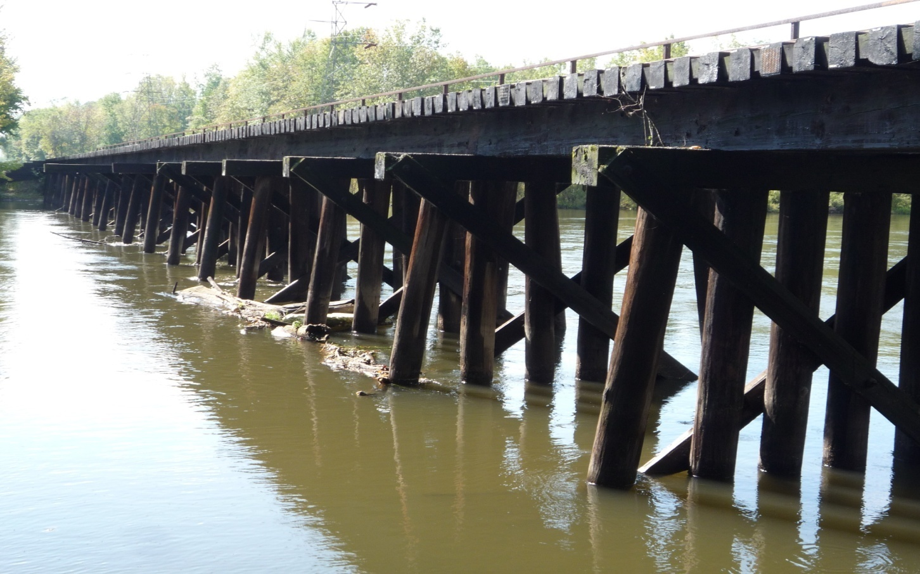

Why build a bridge? Because there is a “chasm, vast and deep and wide.”

Slide 19
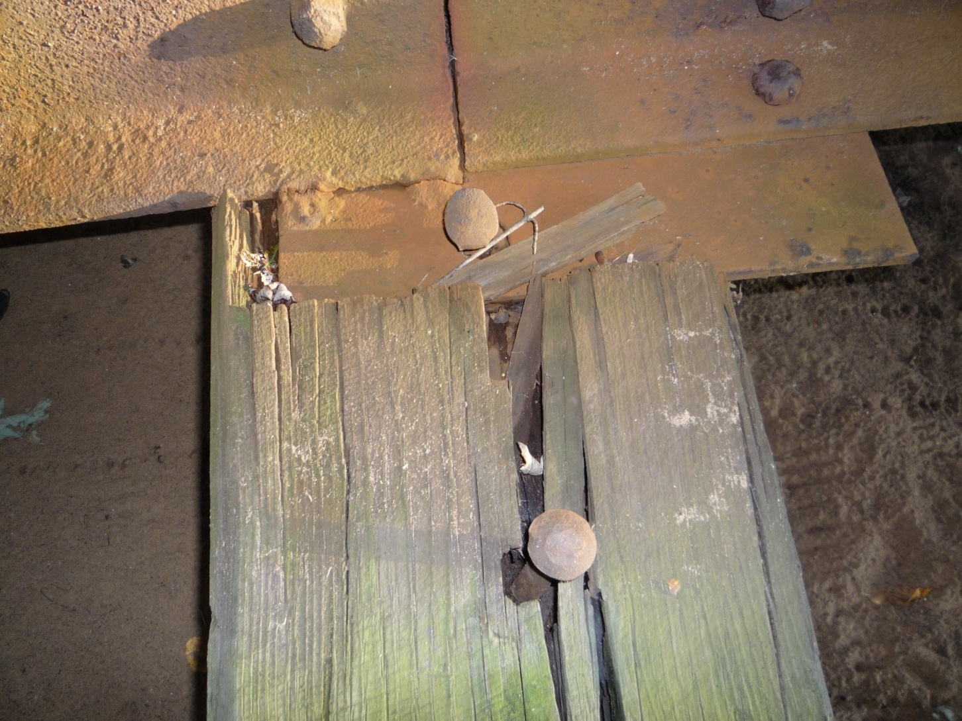
What is more important: Perception….

Slide 20
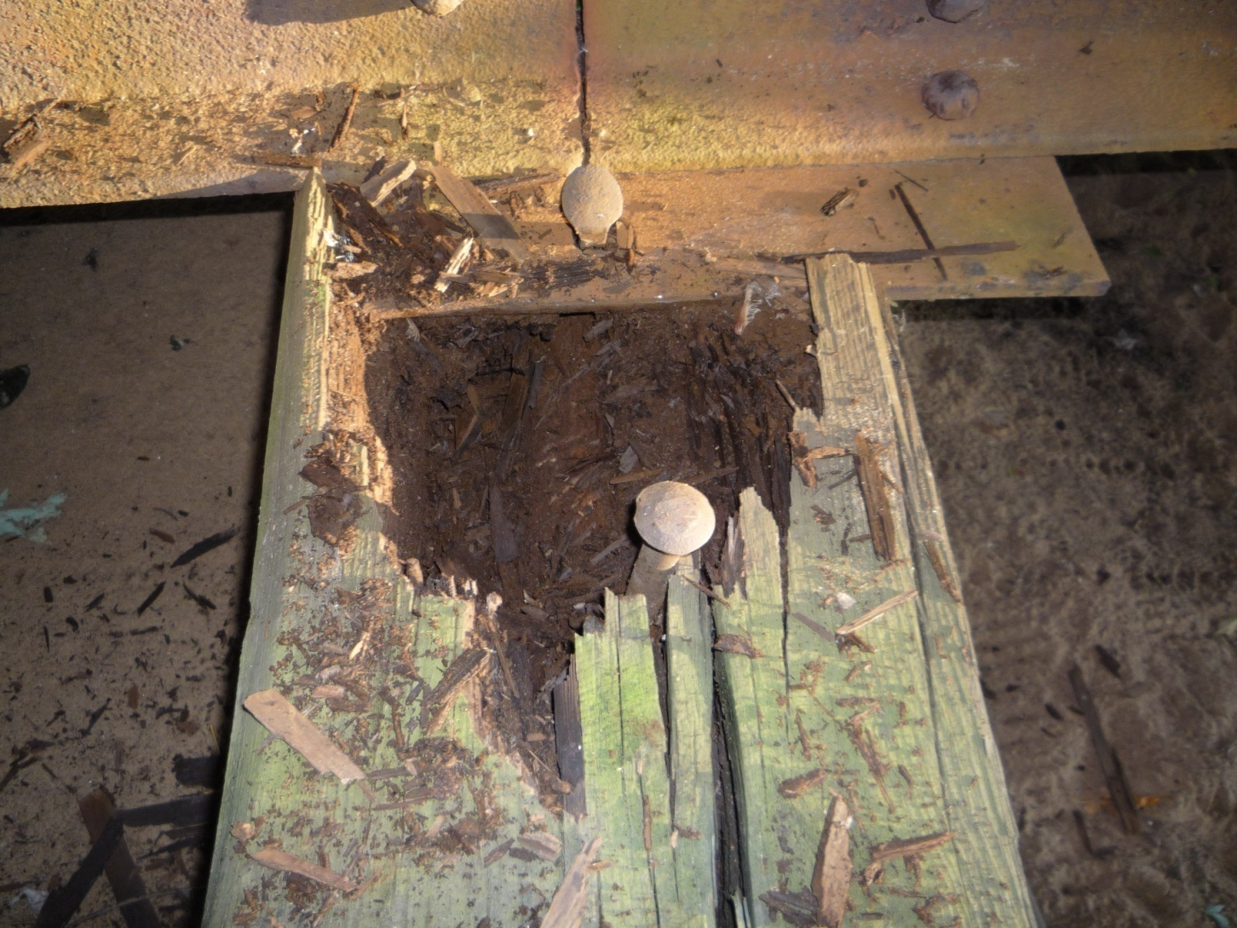
………or Reality?

Slide 21
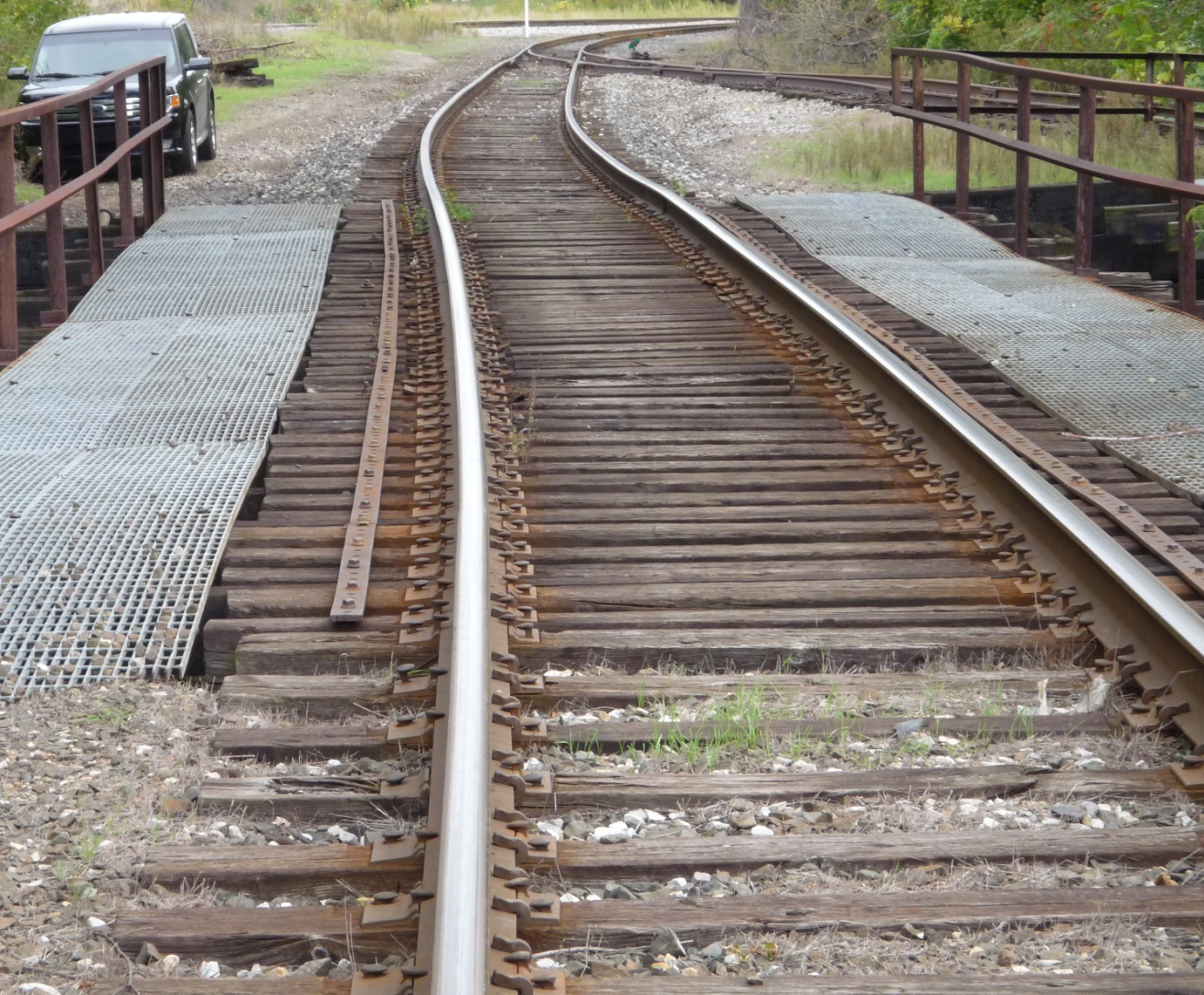
What is more important, what you see every day………

Slide 22
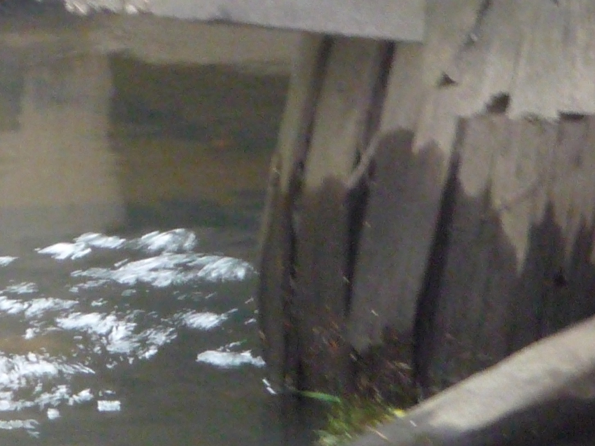
……… or what you look at once a year?

Slide 23
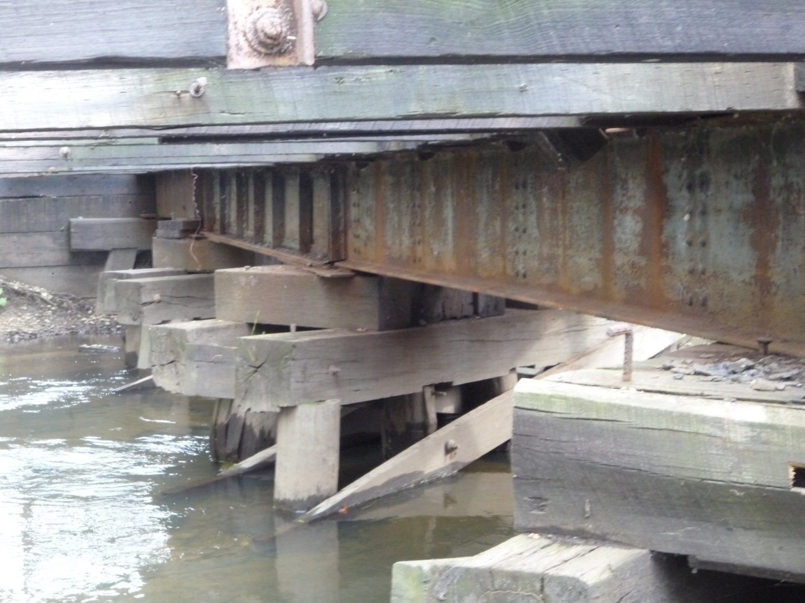
Should you trust in general appearances
…. or

Slide 24
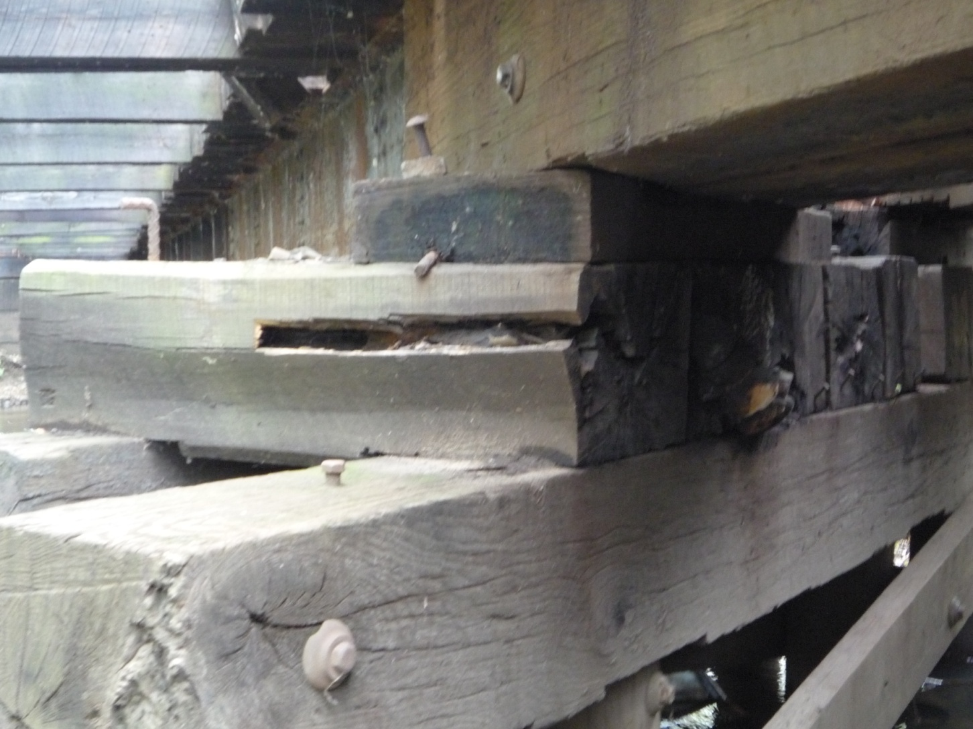
……. the reality of …..

Slide 25
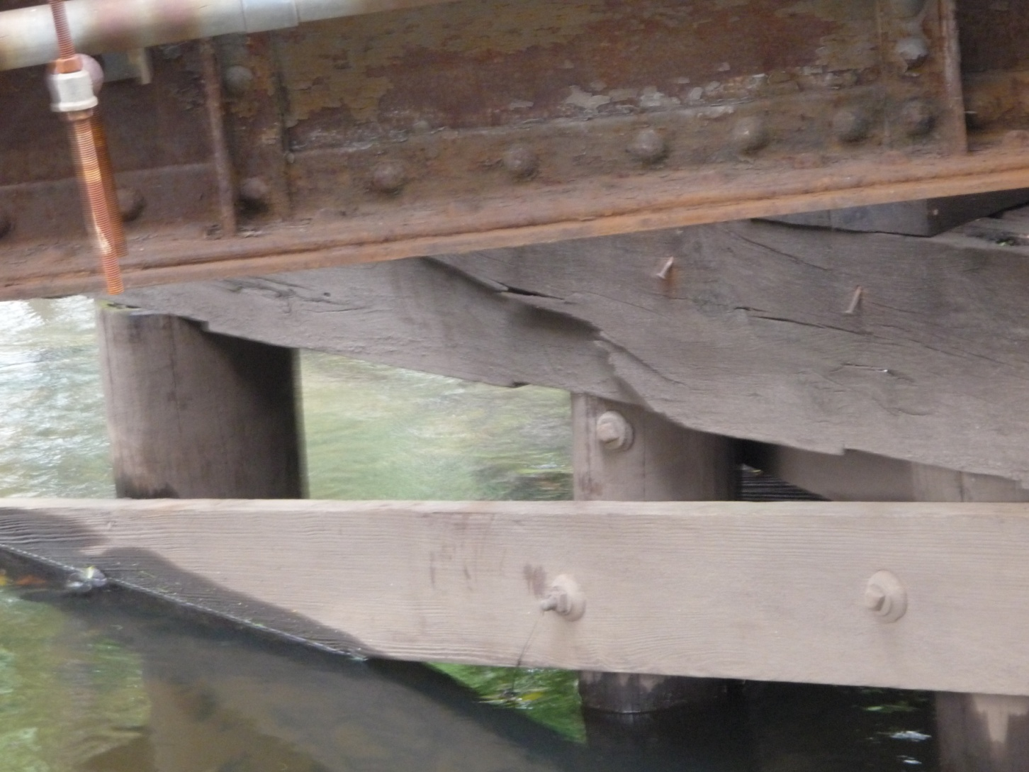
….the Underlying Truth?

Slide 26
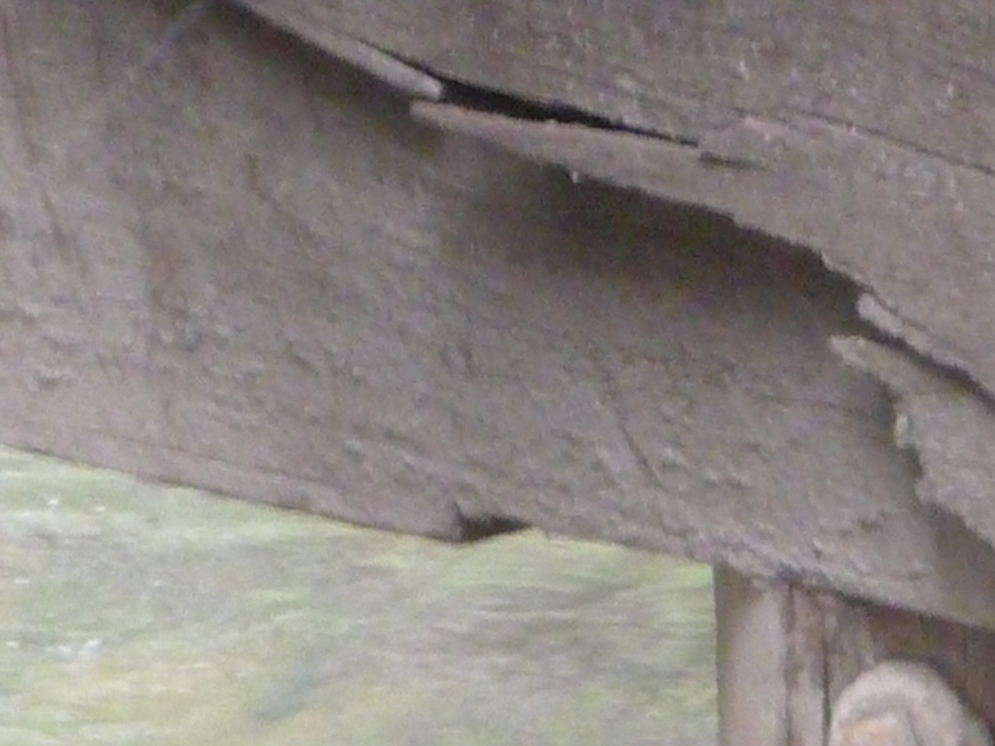
Looks solid at first but upon review it may be soft.

Slide 27
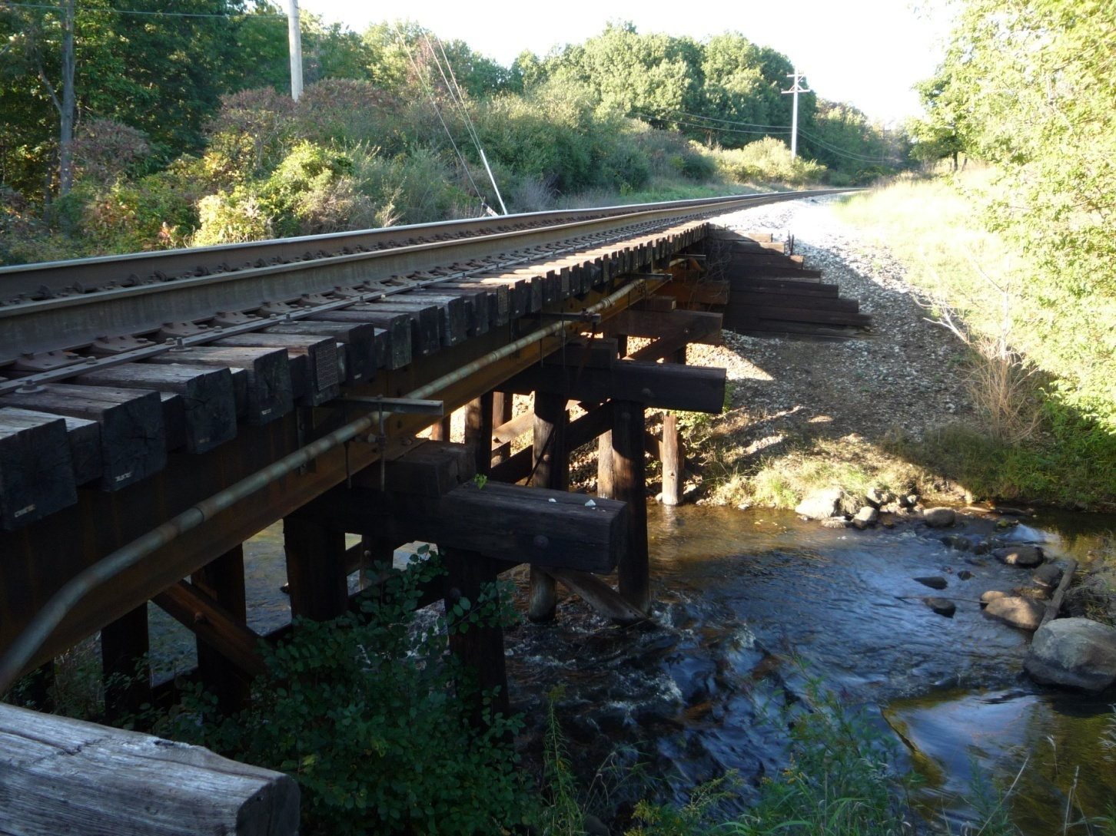
What appears at first glance to be solid enough for timetable speed……….

Slide 28
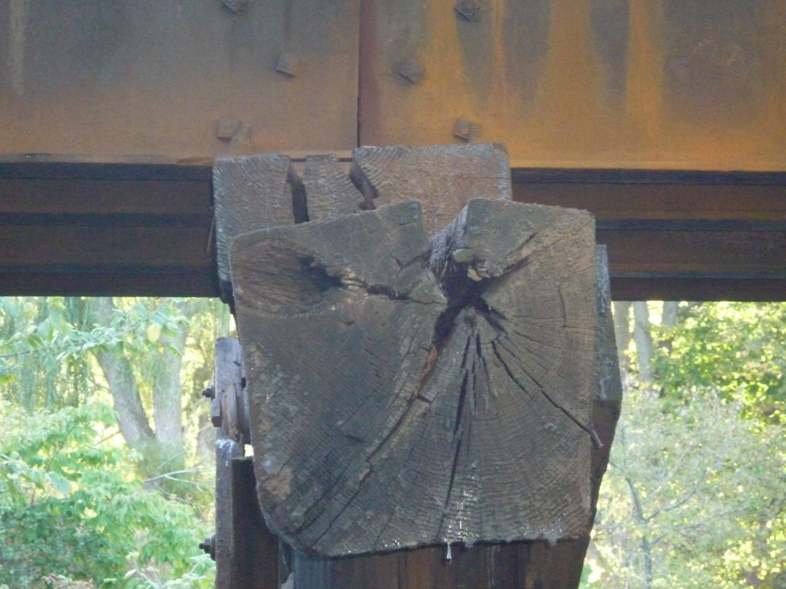
…..may contain a few unpleasant surprises.

Slide 29
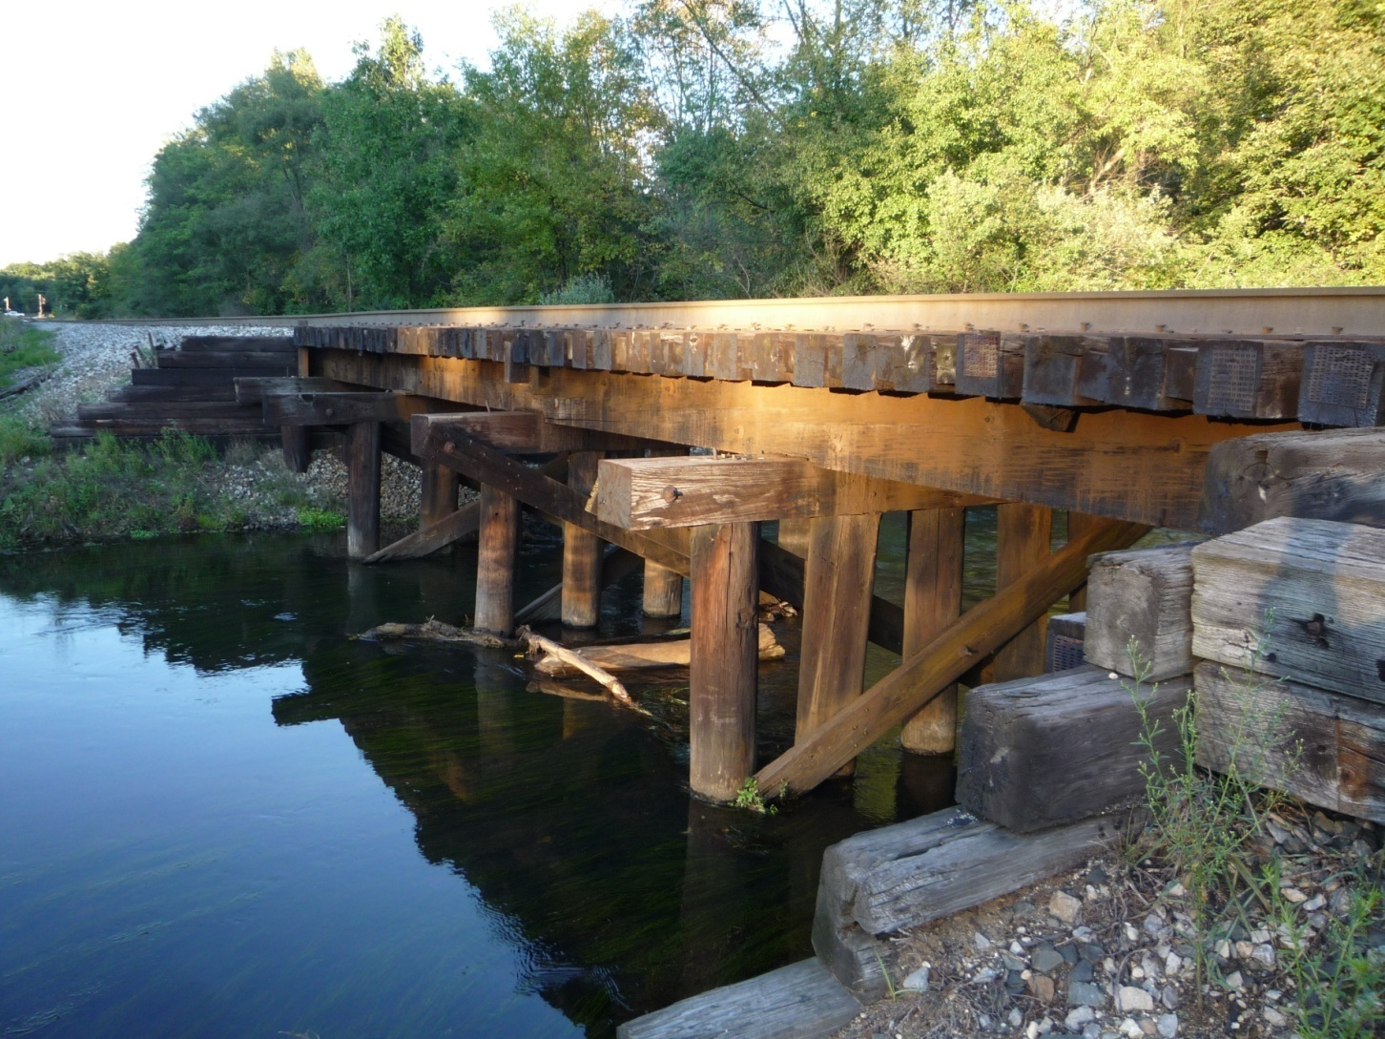
Beauty at first sight………….

Slide 30
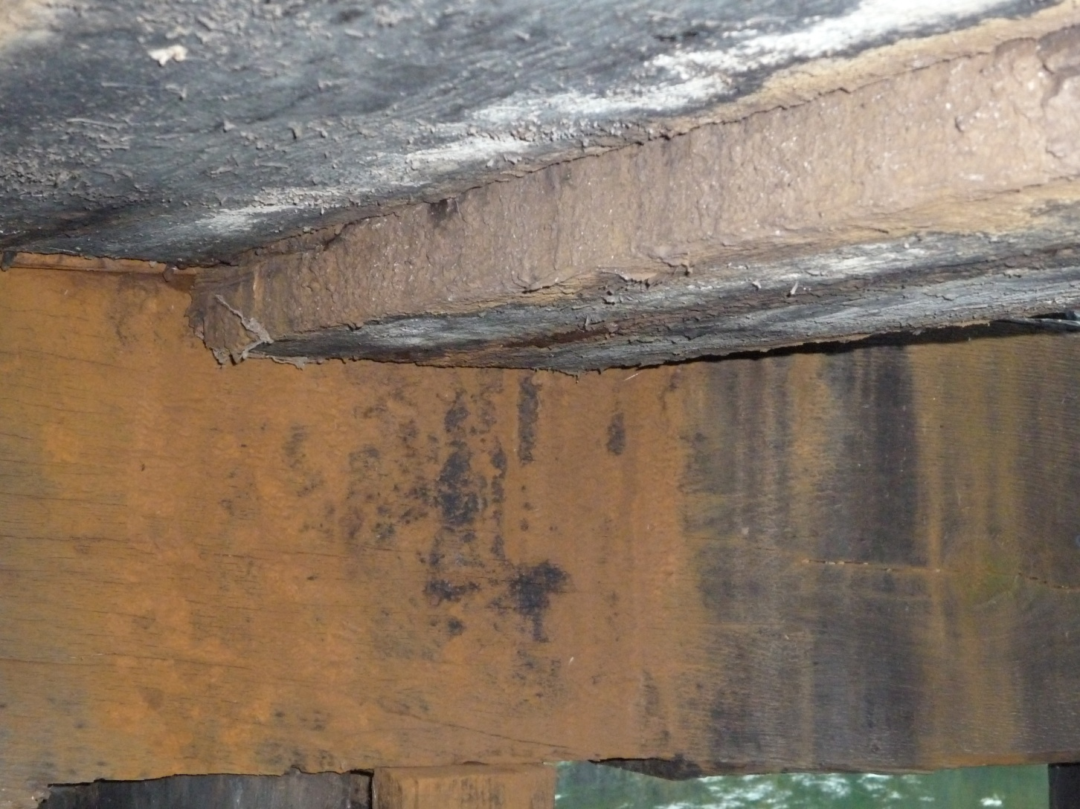
May be only skin deep!

Slide 31
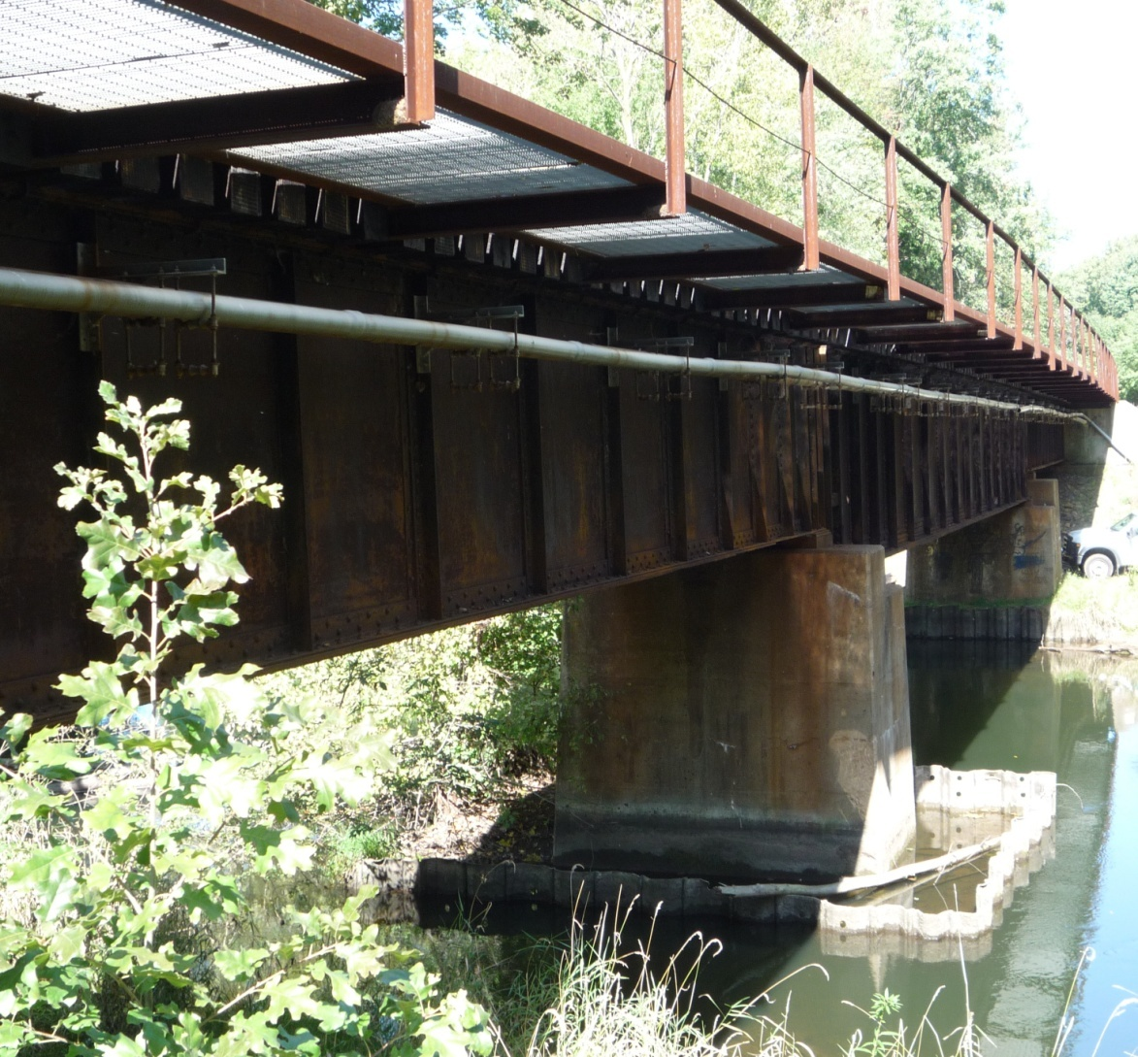
Look – steel and concrete!!! ……….

Slide 32
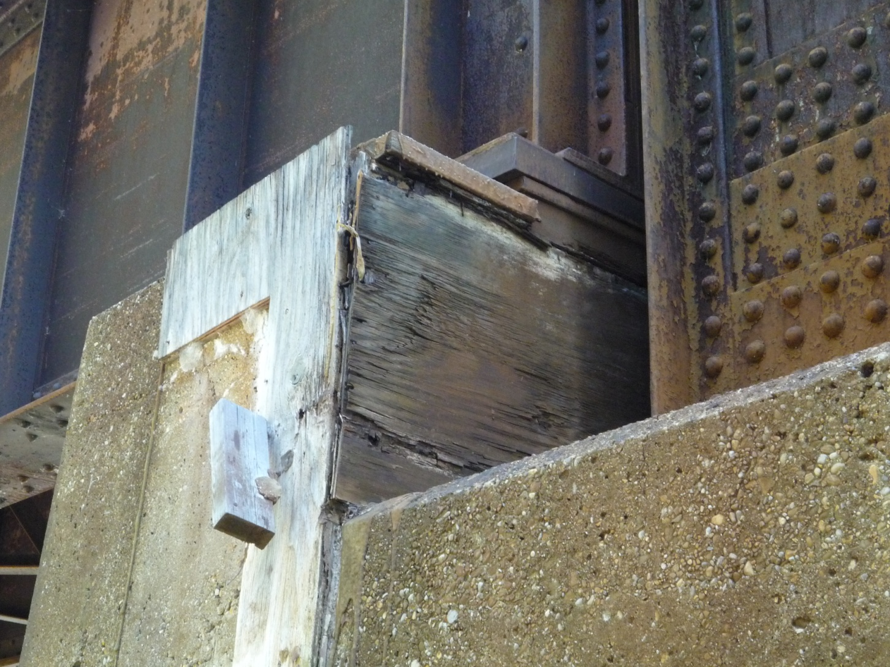
..….but keep on looking…..

Slide 33
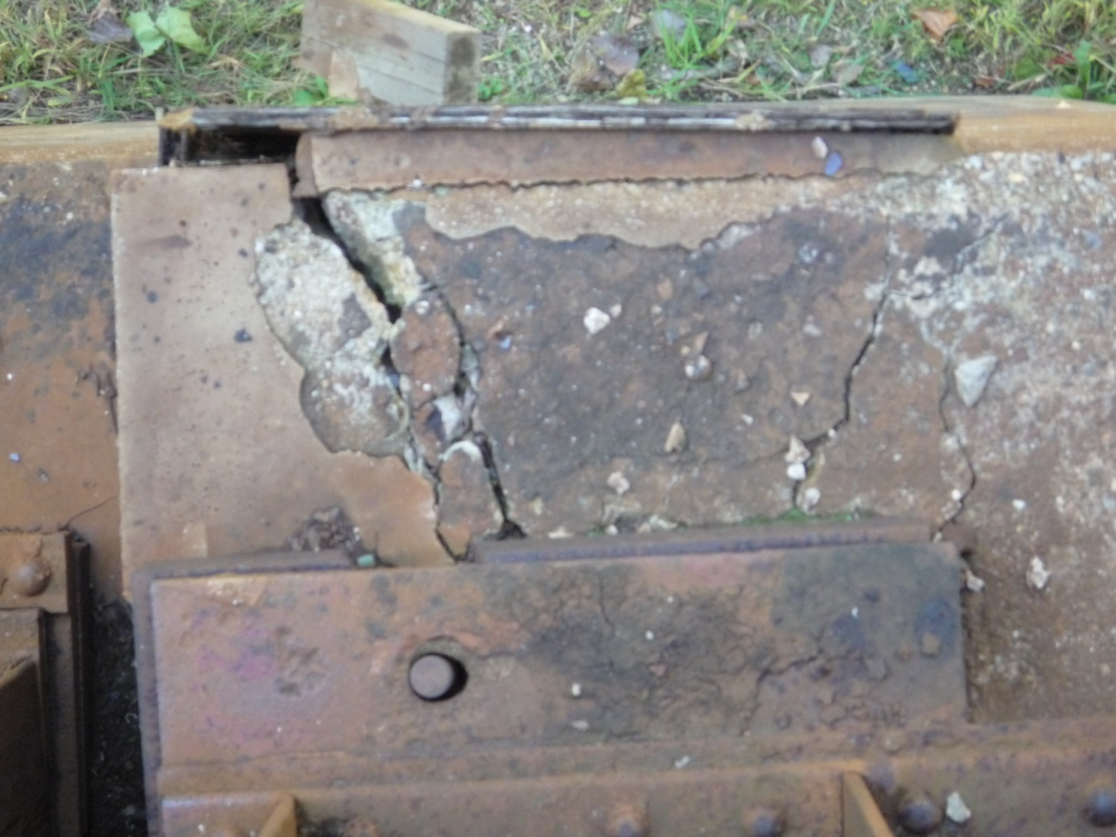
……...and looking…….

Slide 34
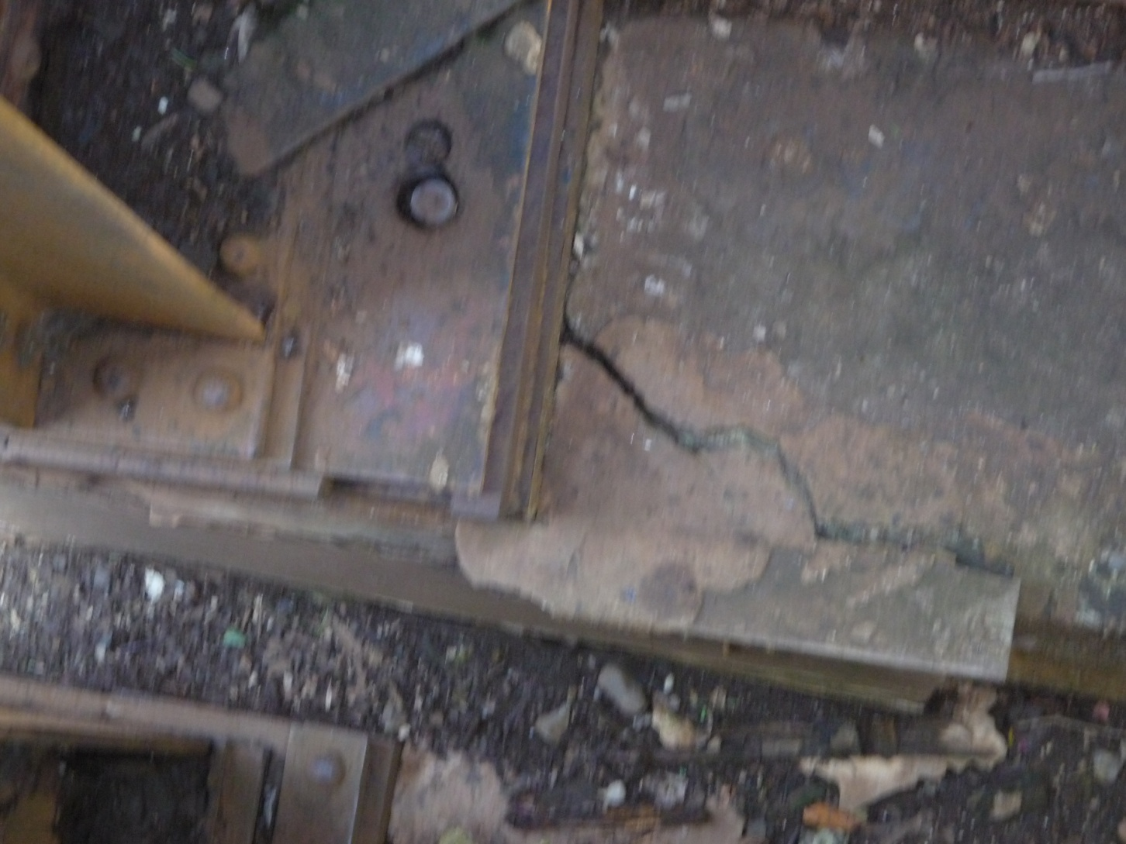
……….and looking.

Slide 35
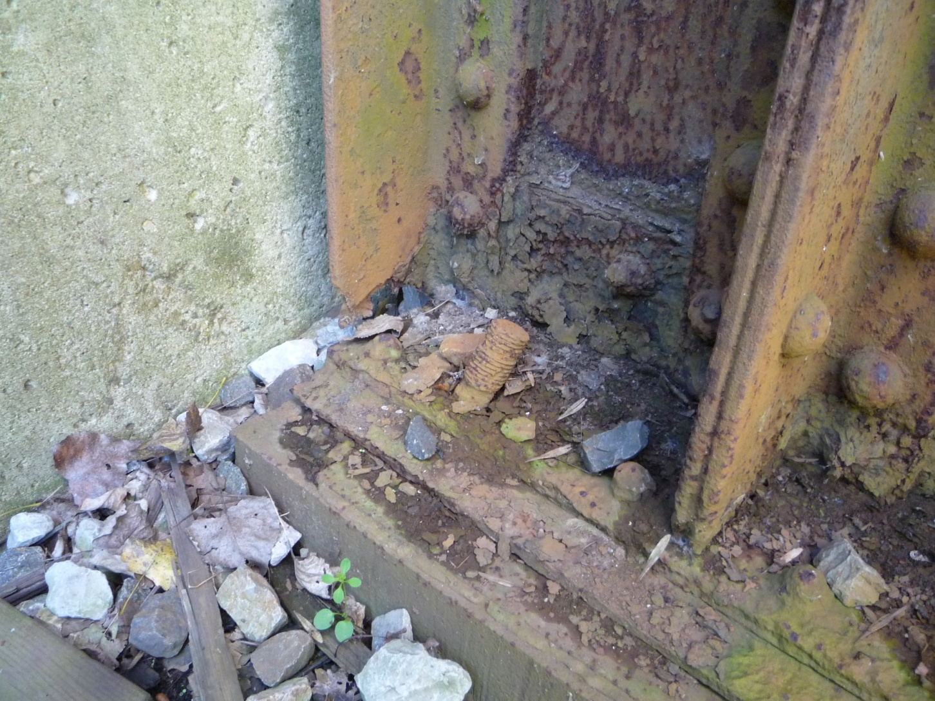
“Bad company corrupts……..

Slide 36
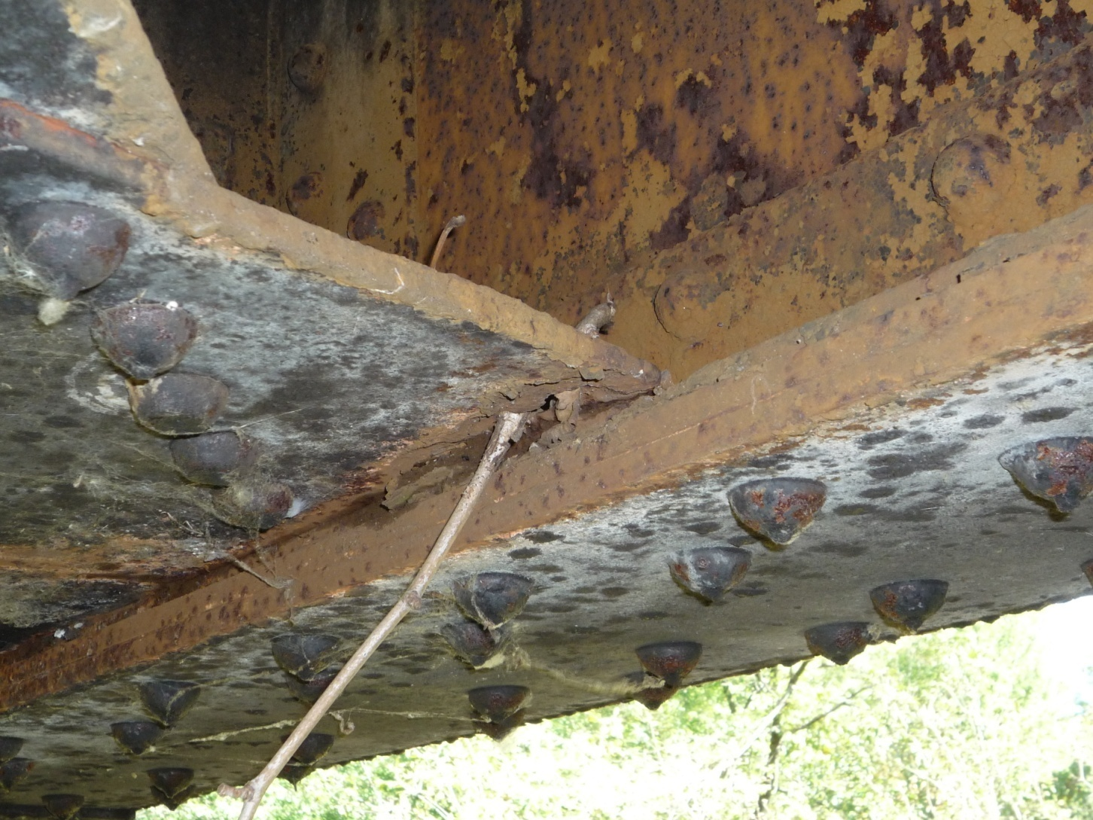
……good character.” I Corinthians 15:33

Slide 37
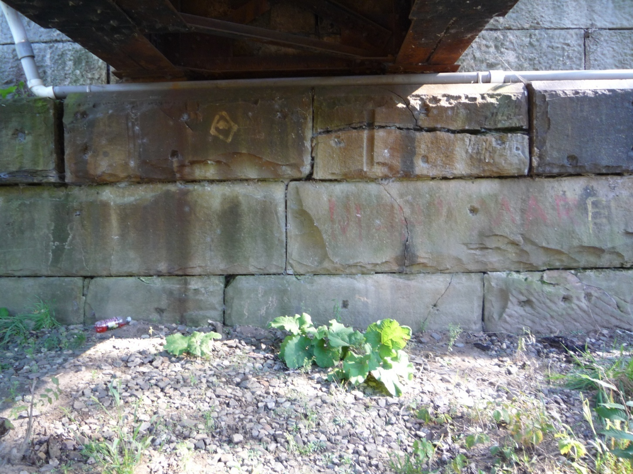
Build your life and your bridges upon a solid foundation…..

Slide 38
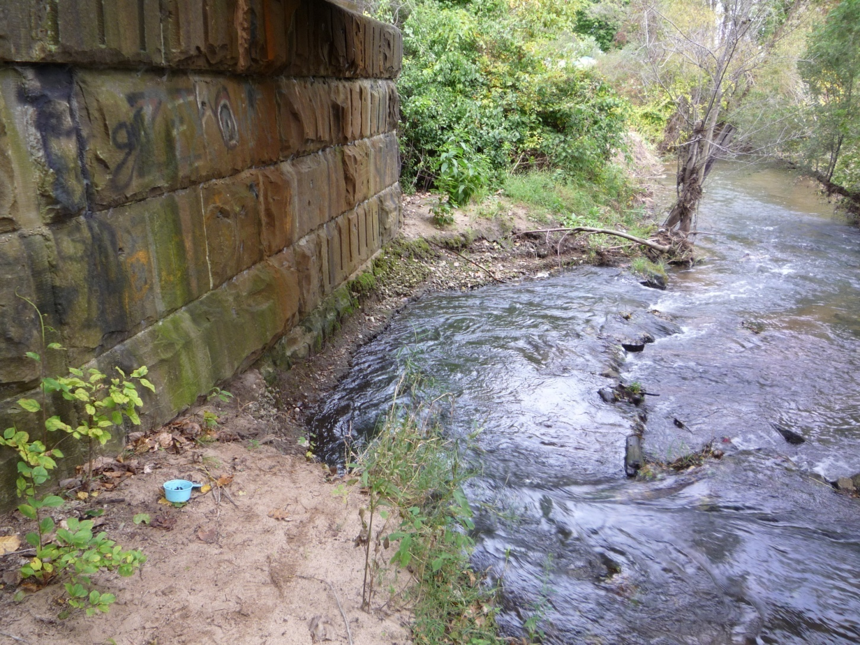
Not on the sand…………..

Slide 39
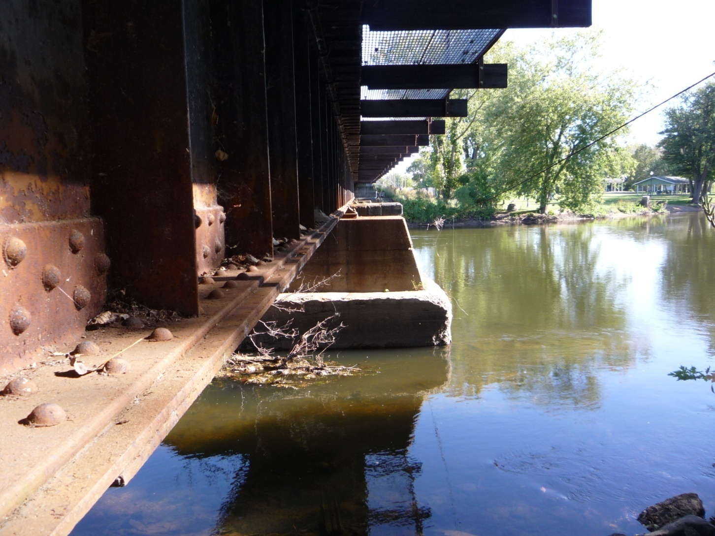
Trust …….

Slide 40
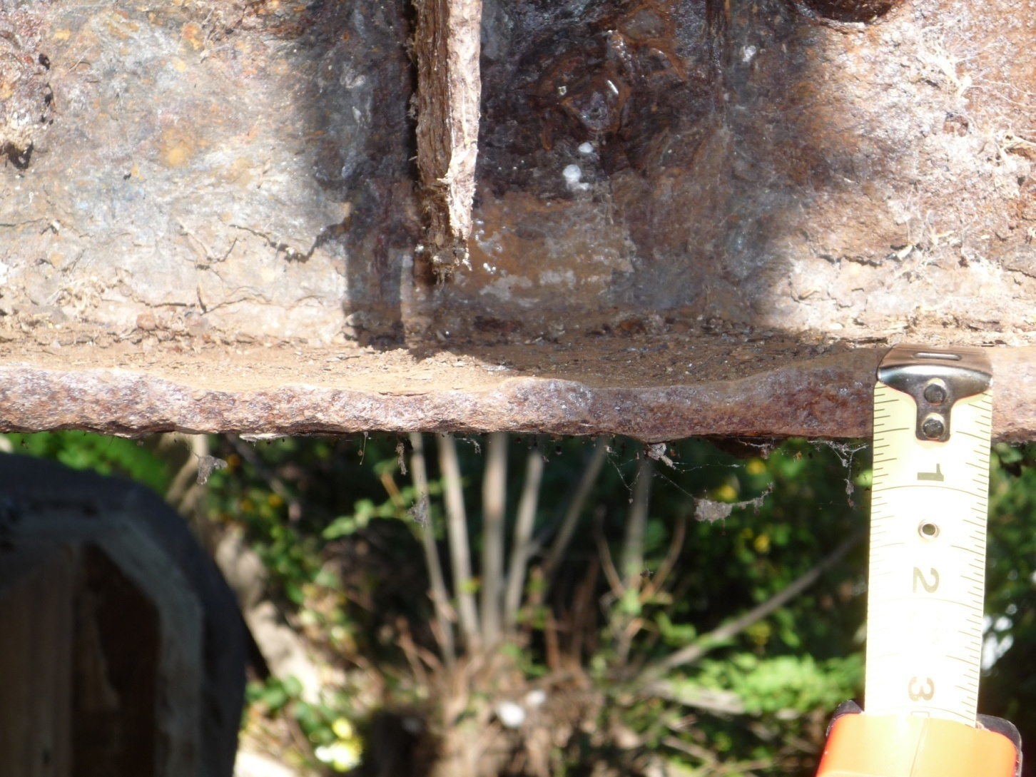
…….but Verify. President Ronald Reagan

Slide 41
“
Food is essential to life, therefore make it good.” Truett Cathy
Bridges are essential to life and to safe railroading, therefore make yours STRONG!
Strong enough for your current traffic and for future needs as well. “Good friend, I am building the bridge for him!”

Slide 42
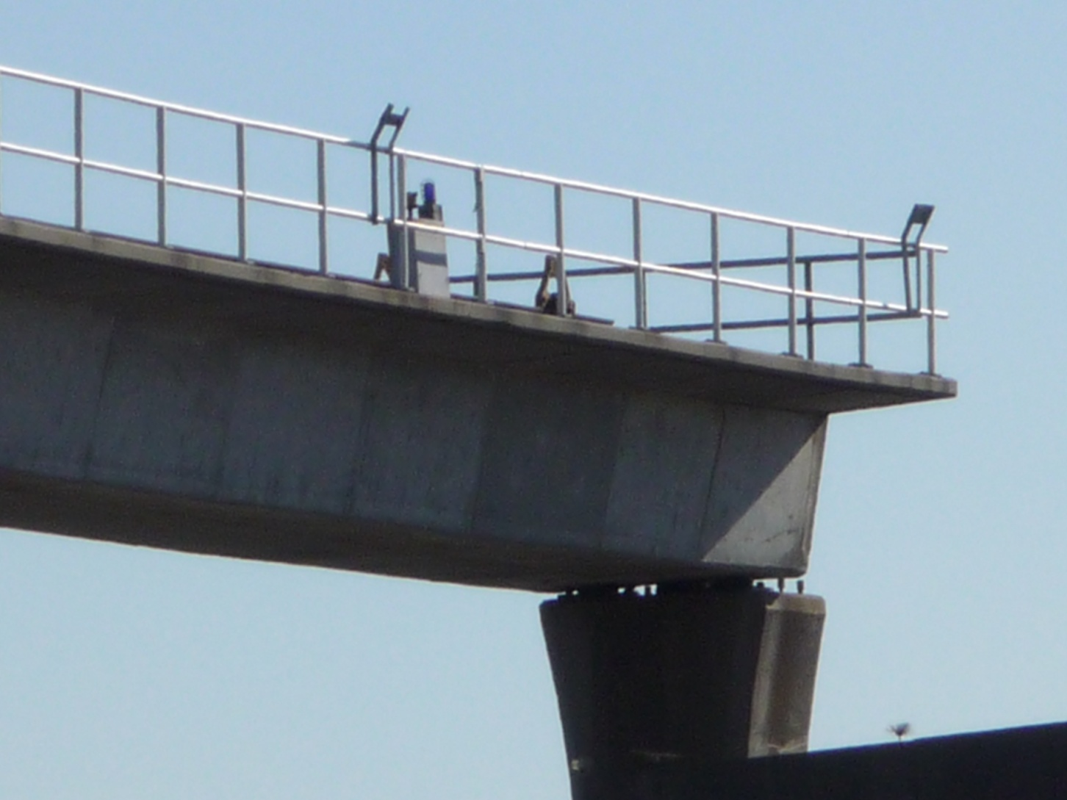
Most importantly, make sure all of your bridges go somewhere instead of nowhere.

